Slide 1
A Sustainable Planet
Week 9
Low Carbon Energy
Dr Vicky Coker
Department of Earth and Environmental Sciences
vicky.coker@manchester.ac.uk; Williamson Building

Slide 2
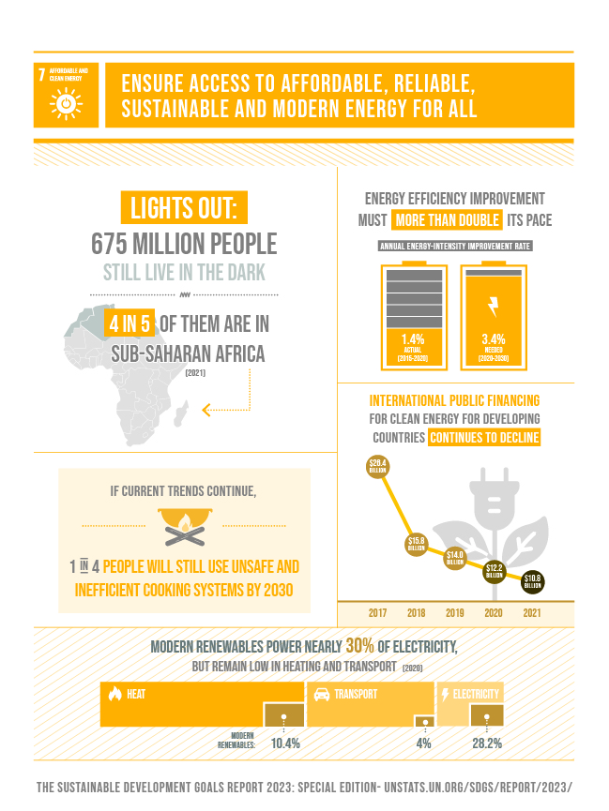
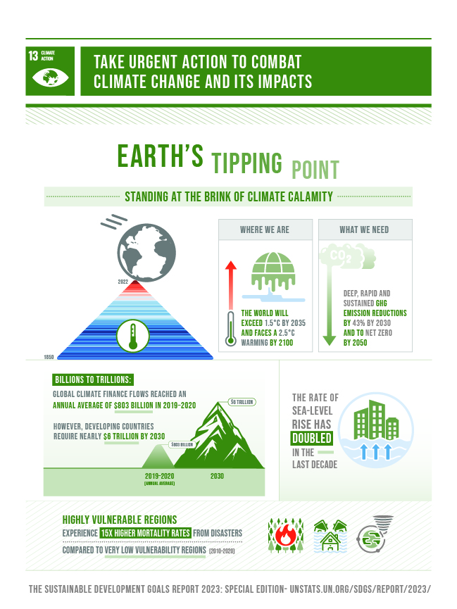

Slide 3

Learning outcomes
Uranium
  Geology
  Mining
  Processing
Enrichment
Nuclear Fission
Pressurised water reactors
Comparison with fossil fuels
What to do with the waste?

Slide 4
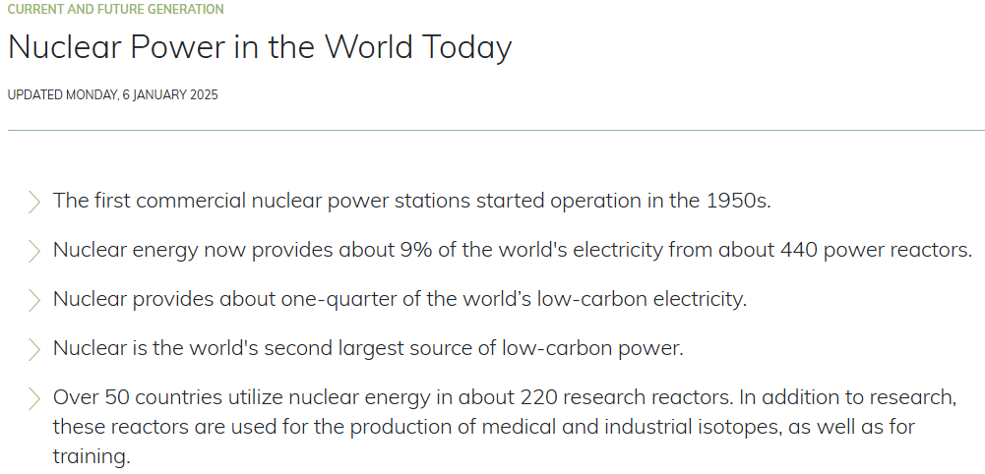
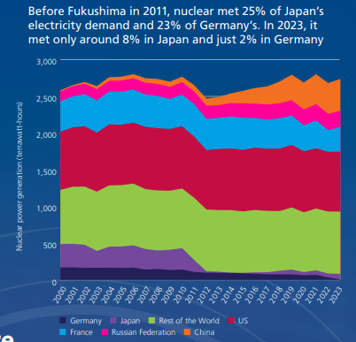
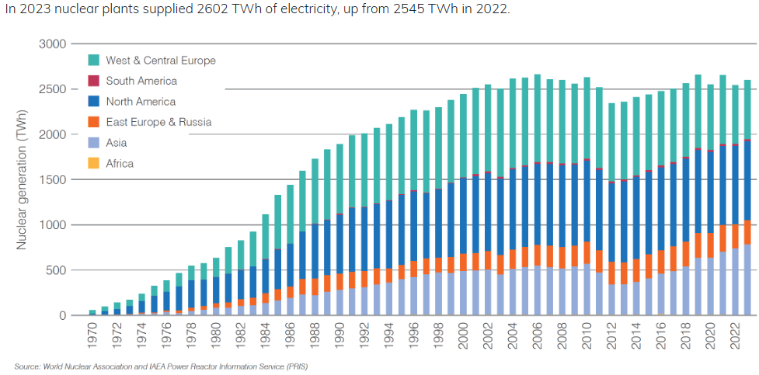
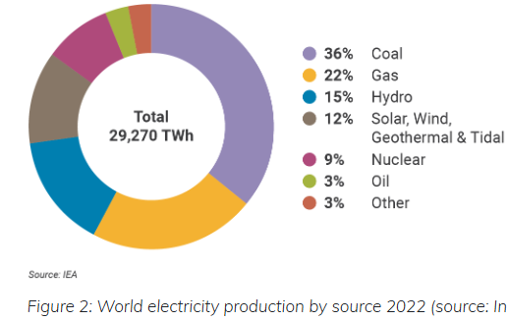
https://www.world-nuclear.org/information-library/current-and-future-generation/nuclear-power-in-the-world-today.aspx

Slide 5
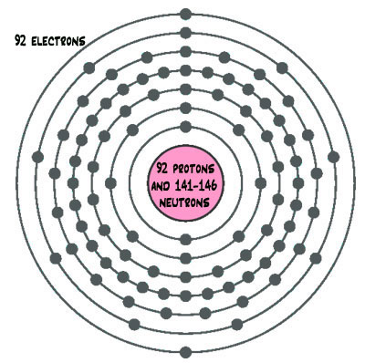
Nature and Origin of Nuclear Power
What do nuclear reactors “burn”?
²³⁵U
=92 protons and 143 neutrons

Slide 6
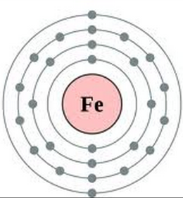
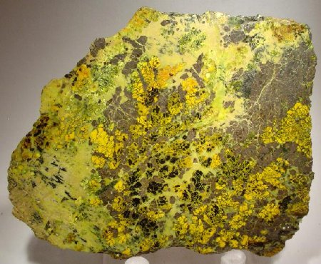
Uranium Occurrence
Crustal abundance of 2.7 ppm
Uranium is a large atom and only fits into certain minerals
e.g. apatite, zircons
Ore of uranium
  uraninite (UO₂)
  pitchblende (U₃O₈)
  +many others
Variety of deposit types
uraninite

Slide 7
Uranium: secondary formation
Most U formed in association with igneous rocks during late stage melt crystallization
However:
  Uranyl transported by groundwaters after leaching the uranium from the solid
  reduced downstream when conditions change = Precipitation of uranium back into a solid = hydrogenic
OR can be deposited as a placer deposit (similar to gold), where density separation concentrates uranium grains
SOLID
oxidation
SOLUBLE
U⁴⁺
U⁶⁺ /uranyl ion (UO₂)²⁺
reduction

Slide 8
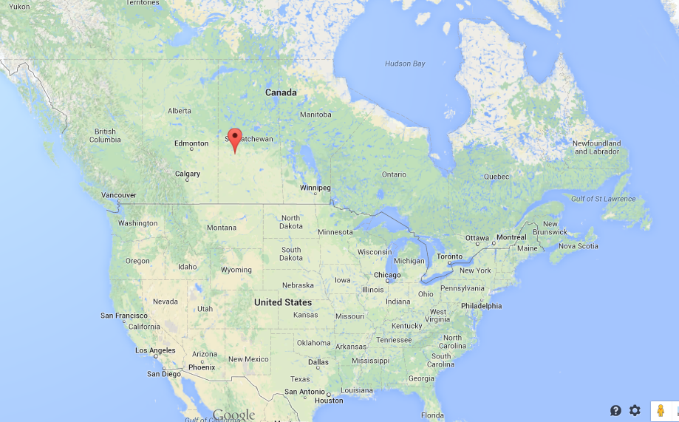
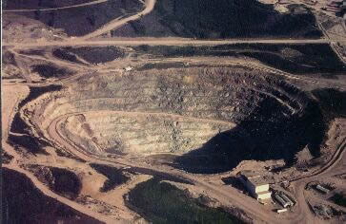
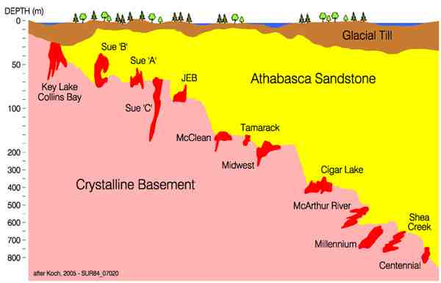
Unconformity deposit:
Athabascan Basin, Canada
longharbourexploration.com
Highest grade uranium deposits e.g. Cigar Lake = 16% U₃O₈
Form in association with the meeting point between metamorphic basement and a sedimentary basin = unconformity

Slide 9
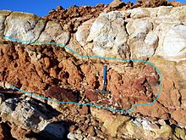
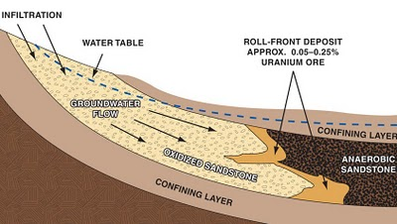
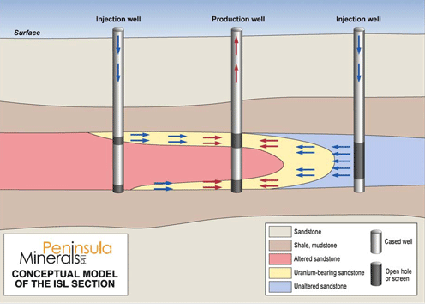
Roll front deposits: e.g. Australia, Kazakhstan
Roll-front deposits shape results from movement through a porous rock, e.g. sandstone, with dissolution and deposition along a curved front.
Mining: In situ leaching (ISL)
Inject a solution that oxidises, solubilises and binds the uranium, then it is pumped out e.g sulphuric acid leaching

Slide 10
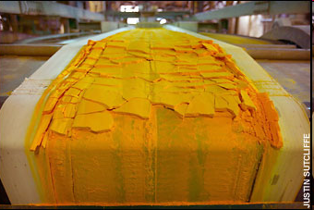
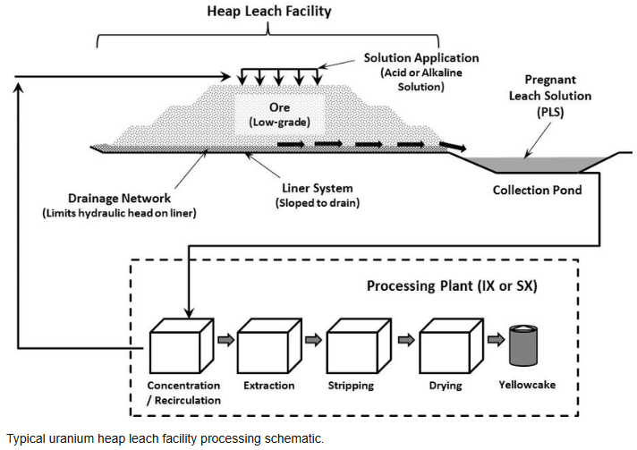
Purification and concentration of U ore
Dynamic treatment (High grade ore > 0.10%)
Crushed and ground mechanically
Processed with chemical solutions
Acid heap leaching (low grade ore-the rest)
.
Yellowcake
~0.7 % ²³⁵U
Solid, concentrated uranium is obtained called "yellow cake" containing around 75% uranium, or 750 kilograms per metric ton

Slide 11
²³⁵U
Natural uranium
0.7 % ²³⁵U ; >99% ²³⁸U
Pressurised Water Reactor - 3% ²³⁵U
?

Slide 12
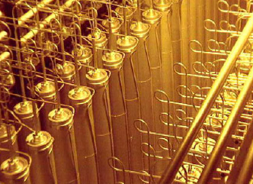
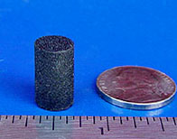
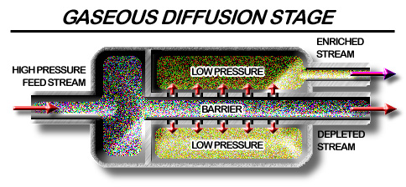
Uranium Enrichment / Fuel
Enrichment
  UF₆ formation = energy intensive
  Gas diffusion to increase ²³⁵U concentration as isotopes have different weights
After gas diffusion, form (in PWR) fuel pellet (uranium dioxide ceramic), fuel rod and fuel assembly
2 – 4 % ²³⁵UO₂
+U²³⁵
UF₆
-U²³⁵
135⁰C
Waste U²³⁸rich = depleted uranium
http://www.klimaatkeuze.nl/wise/monitor/439-440/paitz

Slide 13
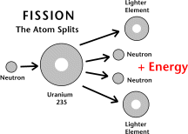
Nuclear reactor 1 x ¹₀n – controlled fission
2 neutrons lost by escape / absorbed by control rods
²³⁵U + ¹₀n → 2 x F.P. + ~ 3 ¹₀n + energy
X
Slow neutron induces nuclear fission (8x speed of sound)
X
1 neutron moderated and fissions with another ²³⁵U atom in the fuel

Slide 14
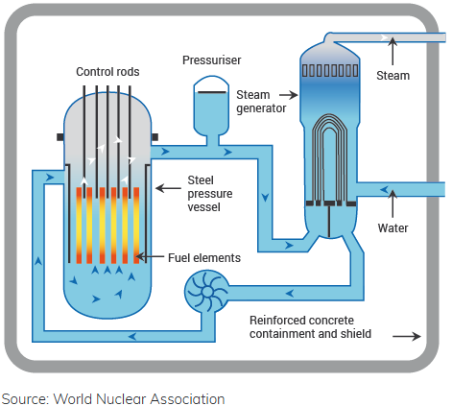
Generic Pressurized Water Reactor (PWR)

Slide 15
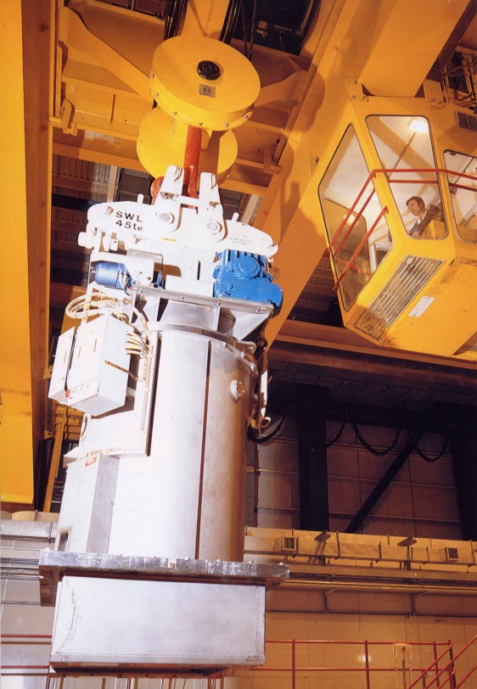
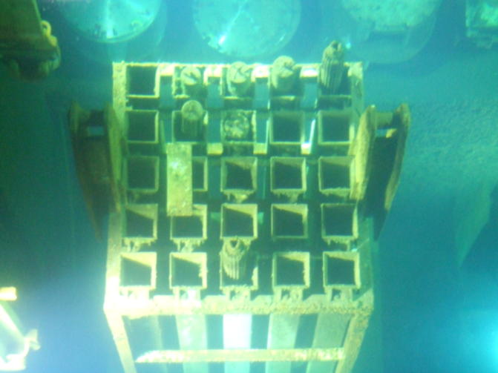
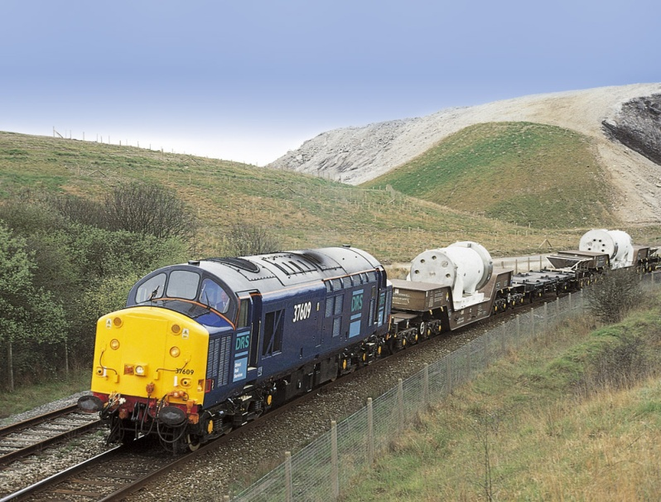
PWR Operation
Fission products “grown into” fuel, have high fission reaction cross sections, fission becomes inefficient
2 – 3 years spent nuclear fuel; radioactive waste
Spent fuel = ~3% FPs; ~1% Pu; 96% ²³⁵⁺²³⁸U
Spent fuel radioactive for 10,000y+ → radioactive waste or reprocessing (“recycle”) to manage the waste component

Slide 16
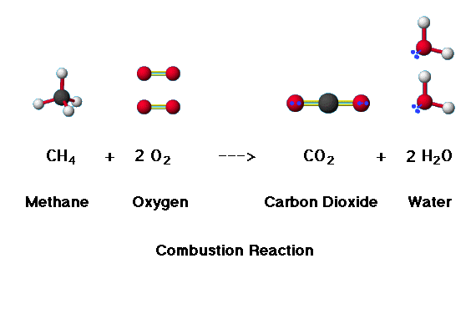
How does it compare to fossil fuel?
Chemical reaction ~4 eV per molecule e.g. combustion of fossil fuels
Nuclear reaction ~ 200,000,000 eV per molecule
1 g ²³⁵U is equivalent to ~2.5 t carbon
Nuclear = Carbon-free at the point of generation

Slide 17
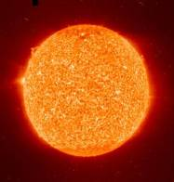
Nuclear waste
What are alpha, beta and gamma radiation?
Where does the waste come from?
How do we classify it?
Legacy waste issues in the UK
How is the UK going to dispose of the legacy nuclear waste?

Slide 18
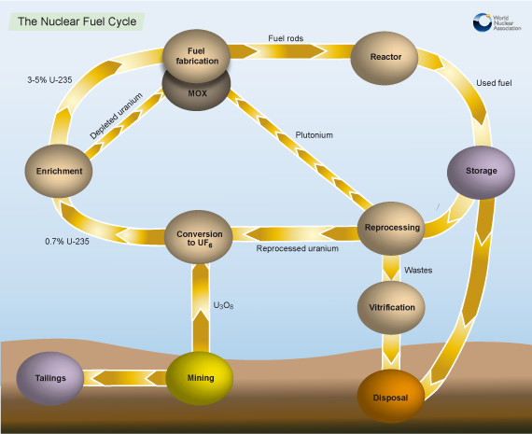

Slide 19
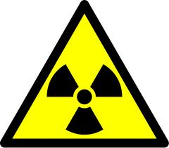
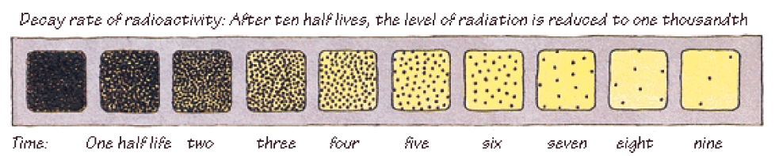
Radioactivity
The ‘half life’ is the time it takes for any given radioisotope to decay to half of its original activity
This varies between isotopes e.g. ^{99m}Tc = minutes, ²³⁷Np = millions of years

Slide 20
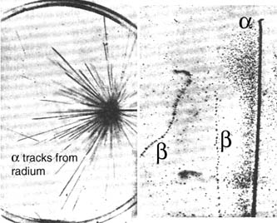
Radioactivity
Radioactivity was discovered in 1896 (Henri Becquerel)
There are 3 types of emission from radioactive decay-
alpha
beta
gamma
Particle radiation from nuclear reactions
- neutrons (important)
- fission products (less so)
Nuclear fission reaction discovered by Hahn and Strassmann in 1938
A “fissile” isotope is one which will undergo a fission reaction itself
A “fertile” isotope is one which can be converted by neutron capture into a fissile one

Slide 21
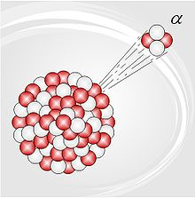
Alpha Decay
Alpha decay is characteristic of heavy nuclei (A > 200)-
U Th + He
236
92
232
90
4
2
2+
●Decay energies are typically 3.5-6 MeV
●Alpha particles are heavy and highly charged so interact readily with matter and have only a short range (5 cm in air)
Pu²³⁹primary decay is via α –decay (half life 24,000yr)

Slide 22
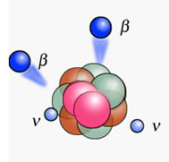
Beta decay - negatron
This decay mode is characteristic of lighter, neutron-rich nuclei, high speed electron or positron
-
H He + e
3
1
3
2
0
-1
● β particles have a range of energies a few keV (³H) up to 2-3 MeV (⁹⁰Y)
● Low mass, medium energy. Less damaging but ~3m in air
e.g. Tc^{99 ,} Cs¹³⁴

Slide 23
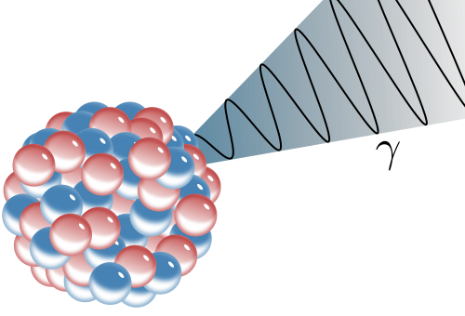
Gamma Emission
α- or β-decay can proceed via an excited state of the product nucleus. The excited state de-excites by emission of a high energy photon, a γ–ray.
⁶⁰Co
β⁻ (E_{max} 310 keV)
100%
⁶⁰Co decay
The total decay energy is partitioned between the particle and the γ–ray.
For some isotopes, like ⁶⁰Co, all decays give rise to γ–emission; in some (²⁴¹Am, ¹³⁷Cs) a proportion of decays do; in some (³H, ¹⁴C), none do.
e.g. Cs¹³⁷
γ 1173 keV
γ 1333 keV
⁶⁰Ni

Slide 24
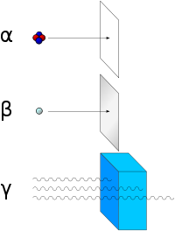
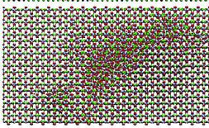
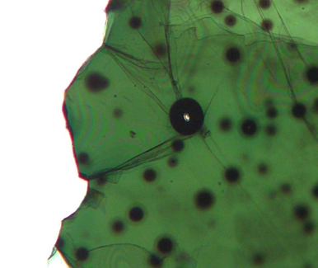

Stopping radiation
Modelled molecular
damage in Zircon
Sheet of paper
Aluminium sheet
Lead blocks
amorphisation
Damage haloes around
zircon in biotite
200μm

Slide 25
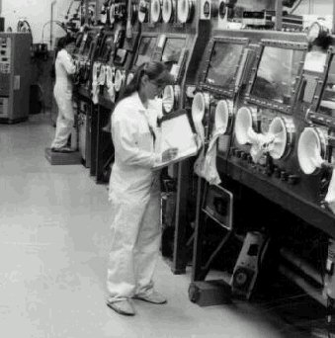
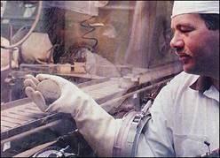
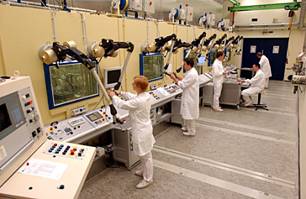
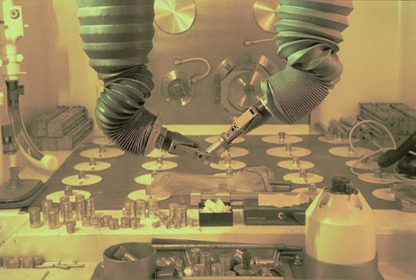
Working With Radioactive Materials

Slide 26
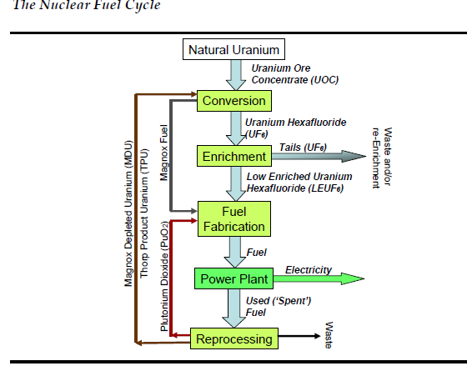
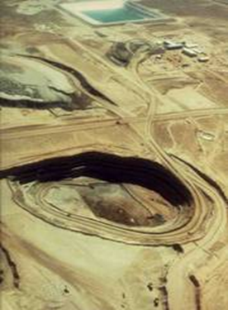
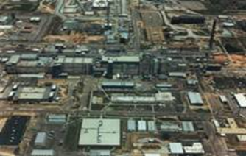
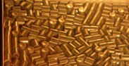
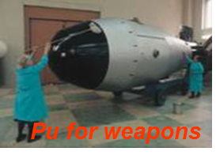
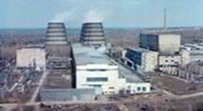
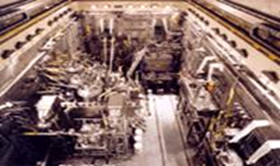
Where is radioactive waste from?
Nuclear
Fuel
Cycle
+
Research & Development (R&D)
RADIOACTIVE WASTE: Material that has no further use, and is contaminated by, or incorporates, activity above certain levels defined in UK legislation is known as radioactive waste.

Slide 27

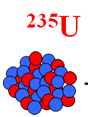
Fuel Rods: hottest properties
Fission fragments
Cs, Sr, Tc, I
²³⁵U
neutron
Short lived
Isotopes. Half-life
milleseconds
to years.
Radioactive and hot
Transuranics
²³⁸⁻²⁴¹Pu
Long lived Isotopes. Half-life
thousands to 100s thousands of years. Radioactive and produce daughters.
²³⁸Np
²⁴¹Am
2 – 3 years operations – full of breakdown products
Spent fuel = ~3% FPs; ~1% Pu; 96% ²³⁵⁺²³⁸U
1 million X more radioactive than they went in.

Slide 28
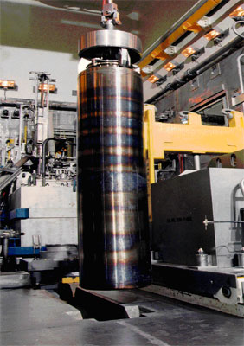



Radwaste definitions
High-level waste: (HLW)
  Produces radioactivity and heat.
  From reprocessing spent fuel, nitric acid solutions and glasses
Intermediate-level waste (ILW)
  High radioactivity but little heat
  Steel, graphite, concrete, cement and sand, sludges etc. (e.g. from buildings)
Low-level waste (LLW)
  Wastes less than 4 GBqs per tonne of alpha activity or 12 Gbq per tonne of beta/gamma activity
  Plastics, paper and metal, soils, building materials and plant.
Very low-level waste (VLLW)
  Controlled or general landfill depending on volume.
https://ukinventory.nda.gov.uk/wp-content/uploads/2021/03/20201222-Official-Rep-PO023346_fact-sheet-03.pdf

Slide 29



Volume of waste-the challenge
Approx. 450,000 m³

Slide 30



Sellafield
70% by volume already at Sellafield
70% HLW/ILW at Sellafield (volume)
Radioactivity % much higher as all HLW and Spent Fuel is sent there

Slide 31
So what can we do with the waste?

Slide 32




Sea Dumping 1948-1982
High level 1972
All wastes 1994
UK 35000 TBq in the Atlantic
(USA at least ‘34282 containers’)

Slide 33





Early bad habits!
Sellafield
Dounreay

Slide 34




Waste at Sellafield, Cumbria

Slide 35

Geological disposal
Multi-barrier method
  Wasteforms
  Casing for waste
  Engineered barrier system
  Geosphere
Last for 10⁶ years

Slide 36



Deep Geological Disposal
Should we be able to access the waste again?

Slide 37



What do we need to know?

Slide 38
Summary
Waste materials will take up to a million years to be considered ‘safe’
The nuclear waste comes from every part of the nuclear fuel cycle from mining the uranium to reprocessing the spent fuel
There have been many different scenarios for disposal
Deep geological disposal is the UK method
But where exactly to put it…?

Slide 39
A Sustainable Planet
Low Carbon Energy
Dr Vicky Coker
Department of Earth and Environmental Sciences
vicky.coker@manchester.ac.uk; Williamson Building

Slide 40
Learning outcomes
Why low carbon?
Discussion of the sources of low carbon energy
  Wind
  Hydroelectric
  Solar
  Biofuels
  Geothermal
https://www.iea.org/reports/the-role-of-critical-minerals-in-clean-energy-transitions/mineral-requirements-for-clean-energy-transitions

Slide 41


Energy Institute Statistical Review of World Energy 2024

Slide 42
Natural Energy Flows
Note: 1Q = 10²¹J
Mean Solar Input 342 Wm⁻² or 5500 Q/year
Reflected radiation (albedo 30%) 1650 Q/y
Photosynthesis 1 Q/y
Mean tidal power assoc with Earth-Sun-Moon ~ 0.1 Q/y
Absorption and re-radiation 3850 Q/y
Earth
Evaporation and precipitation 1300 Q/y
Atmosphere
Geothermal outflow from Earth ~ 1 Q/y
Solar power assoc. with winds waves and currents 12 Q/y

Slide 43


Slide 44


Wind turbine
Kinetic energy = 0.5mv²
m = ρAv
Therefore:
KE per sec (power)
=0.5ρAv³
m = mass of air through turbine
v = velocity of the air
ρ = density of the air
A = swept area of the turbine
Wind turbines rotor blades, made from e.g. fibreglass-reinforced polyester
30-80 m diameter
the longer the blades, the greater the energy output.
rotate at 10-30 revolutions per minute
Rotational energy is converted into electricity

Slide 45



https://www.renewableuk.com/energypulse/ukwed/
https://grid.iamkate.com/

Slide 46


Fluctuations
MacKay, 2009

Slide 47
Hydroelectric power
Usually generated at large dams in order to increase the vertical drop of the water
Energy available (in J) = m x g x h
  m = mass of water available in kg
  g = acceleration due to gravity (9.81 ms⁻¹)
  h = height differential
By using two reservoirs at different heights, water can be pumped uphill to store energy during periods of low demand

Slide 48


Slide 49


Three Gorges Dam, China
Largest hydroelectric dam in the world since completion in 2012
Generating capacity of 22,500 MW
However power limited at certain times of the year due to water availability
Height =181m and over 2km in length
Creates the 3 Gorges Reservoir which extends 600 km upstream

Slide 50


UK Hydroelectric power
Exploited in the UK
Large installations can harvest this energy very efficiently (up to 95%)
1-2% of our electricity generation
https://www.carbonbrief.org/mapped-how-the-uk-generates-its-electricity

Slide 51


Solar power

Slide 52


Solar electrical generation
Photovoltaic technology
Concentrated Solar Power (CSP)

Slide 53

Photovoltaic cell
Semiconductor e.g. Silicon, GaAs, CdTe
N-type silicon: addition of impurity creates extra electrons e.g. P
P-type silicon: addition of impurity creates ‘holes’ for electrons e.g. B
Transfer of energy from the light (photon) to the extra electrons
Electrons move generating a current

Slide 54

Biofuels and waste products
Any solid, liquid or gaseous fuel derived from recently living organisms
Using crops as a source of fuel means that any carbon released through combustion is offset by carbon absorbed as the plant grows
Can be a direct replacement for petrol/diesel or used for electricity generation

Slide 55

Some fuels can be direct replacements for fossil fuels (e.g. biodiesel, biogas)
Some can be produced from by-products, easing the pressure on farmland used for other crops
  e.g. biogas from food waste and sewerage, wood pellets from sawdust

Slide 56

Geothermal power

Slide 57

Geothermal power

Slide 58

Locations of geothermal sites
https://www.thinkgeoenergy.com/map/

Slide 59

Distribution
The existing national grid is designed around providing the greatest generation capacity close to where demand is greatest (e.g. cities, heavy industry)
In a low-carbon scenario, many of the sources of power are far from the users of the power (e.g. tidal streams in Scotland)
Much work is needed to upgrade the power distribution network as a result

Slide 60


Slide 61
Summary
Substantial amounts of energy could in theory be utilised through non-nuclear low-carbon technologies
Even with the technical capacity, many economic, social and environmental issues will likely make implementing some technologies unfeasible
Part of an energy mix

Slide 63
World Nuclear Association
https://world-nuclear.org/
Read about your own country or one of interest
Post interesting facts related to:
  Do they use nuclear? Why/Why not?
  How are they dealing with the waste?
  Has any country completed a waste repository?
Add to mentimeter to build the discussion

